Slide 1
Gaming gear shop
Web development
0406133262 section 2
Channoot Srisarakam 5904062663034 CSB

Slide 2

Gaming Gear Shop
This website is a store that selling Gaming gear such as Mouse, Keyboard, Headset, Mousepad and other. We select the top brands of gaming gear to sell in the lowest price that possible

Slide 3
Project Scope
1. User can Login/Register from the website and store the information into database.
2. User can add any item into cart and pay them later.
3. Website have the page that user use to notification payment.
4. User can use code for discount.
5. User able to edit own profile.
6. User able to change password.

Slide 4
Project Scope
7. User able to see the purchases status and history
8. Admin able to add item to show on website.
9. Admin able to remove/edit any item.
10. Admin will recive the notification payment from user and mark it pass if the Order is done
11. Admin able to edit user profile

Slide 5
Tools
HTML/CSS
PHP
Javascript
Bootstrap
Phpmyadmin

Slide 6
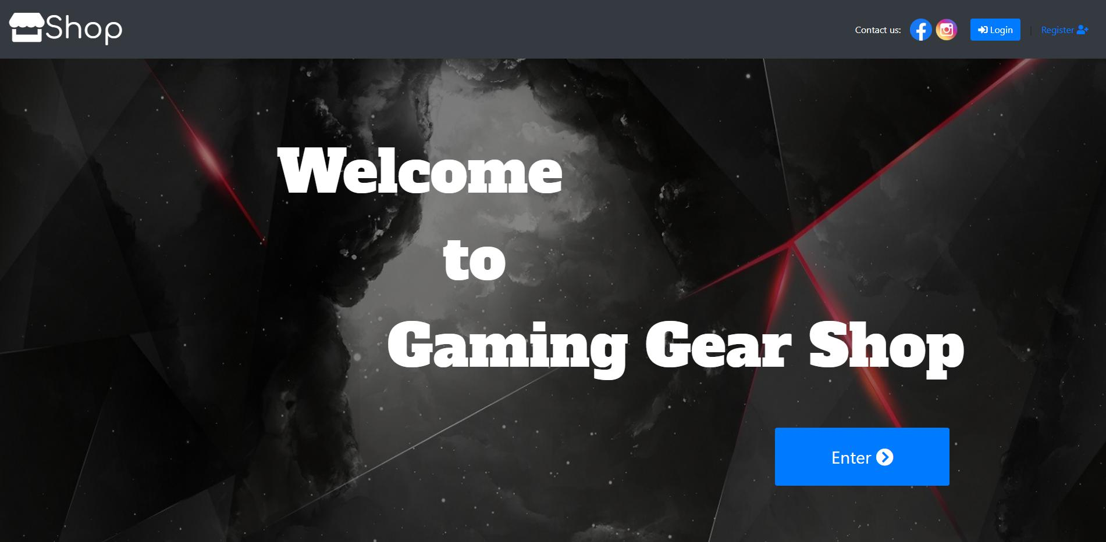
Mock up

Slide 7
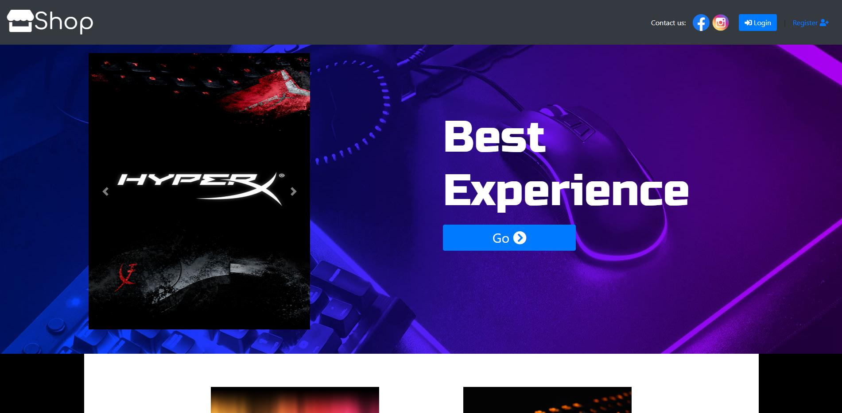
Mock up

Slide 8
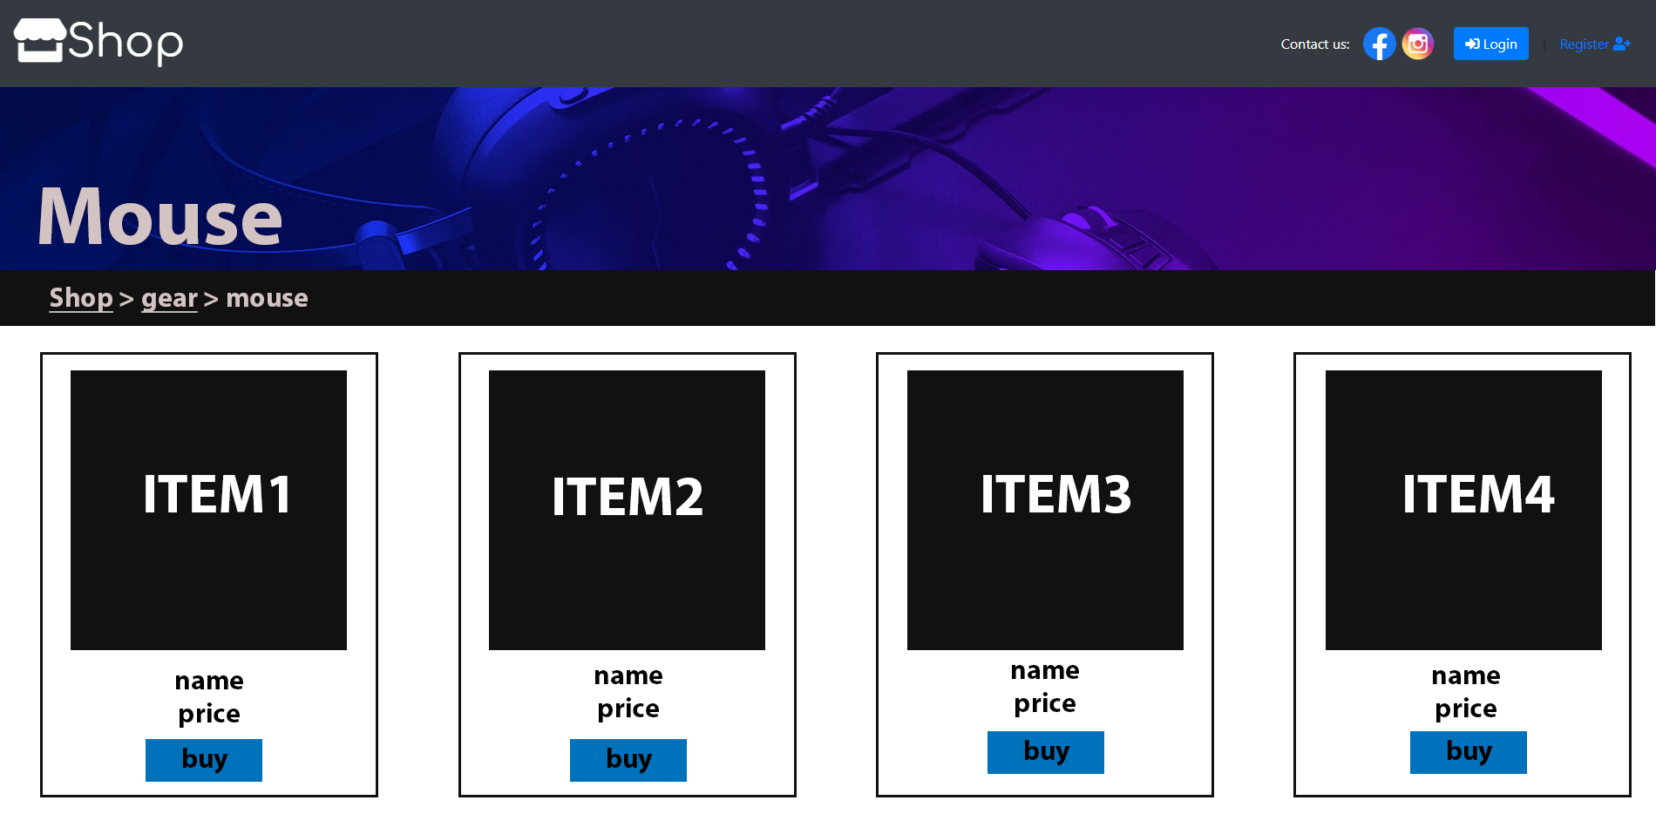
Mock up

